Slide 1

Queue Examples

Slide 2
Example 1 D/D/1/k-1
in a D/D/1/k-1 system, which the arrival rate is equal to (1/3) and the service rate is equal to (1/5). Find the number of customers in the system at t = 11 and 20.

Slide 3
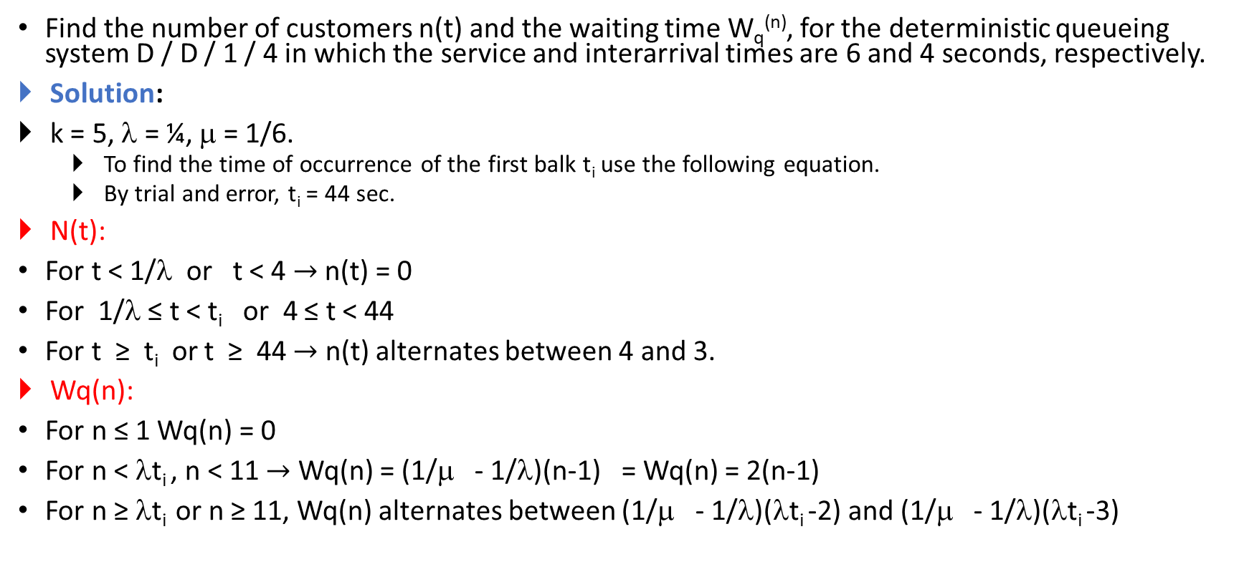
Example 2 D/D/1/K-1 Case1
Find the number of customers n(t) and the waiting time W_{q}^{(n)}, for the deterministic queueing system D / D / 1 / 4 in which the service and interarrival times are 6 and 4 seconds, respectively.
Solution:
k = 5, λ = ¼, μ = 1/6.
To find the time of occurrence of the first balk t_{i} use the following equation.
By trial and error, t_{i} = 44 sec.
N(t):
For t < 1/λ or t < 4 $→$ n(t) = 0
For 1/λ ≤ t < t_{i} or 4 ≤ t < 44
For t ≥ t_{i} or t ≥ 44 $→$ n(t) alternates between 4 and 3.
Wq(n):
For n ≤ 1 Wq(n) = 0
For n < λt_{i} , n < 11 $→$ Wq(n) = (1/μ - 1/λ)(n-1) = Wq(n) = 2(n-1)
For n ≥ λt_{i} or n ≥ 11, Wq(n) alternates between (1/μ - 1/λ)(λt_{i} -2) and (1/μ - 1/λ)(λt_{i} -3)

Slide 4
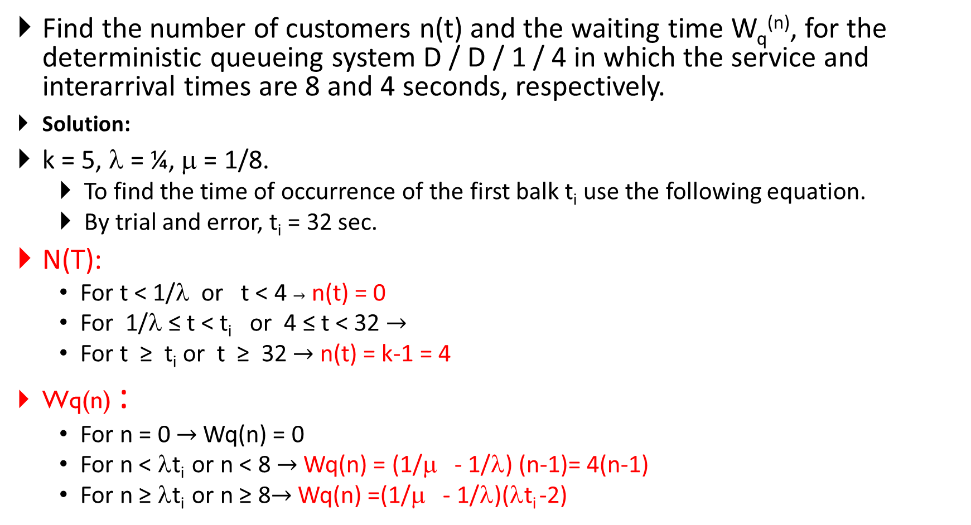
Example 3 Special Case
Find the number of customers n(t) and the waiting time W_{q}^{(n)}, for the deterministic queueing system D / D / 1 / 4 in which the service and interarrival times are 8 and 4 seconds, respectively.
Solution:
k = 5, λ = ¼, μ = 1/8.
To find the time of occurrence of the first balk t_{i} use the following equation.
By trial and error, t_{i} = 32 sec.
N(T):
For t < 1/λ or t < 4 $→$ n(t) = 0
For 1/λ ≤ t < t_{i} or 4 ≤ t < 32 $→$
For t ≥ t_{i} or t ≥ 32 $→$ n(t) = k-1 = 4
Wq(n) :
For n = 0 $→$Wq(n) = 0
For n < λt_{i} or n < 8 $→$Wq(n) = (1/μ - 1/λ) (n-1)= 4(n-1)
For n ≥ λt_{i} or n ≥ 8$→$Wq(n) =(1/μ - 1/λ)(λt_{i} -2)

Slide 5
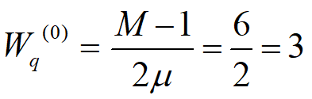
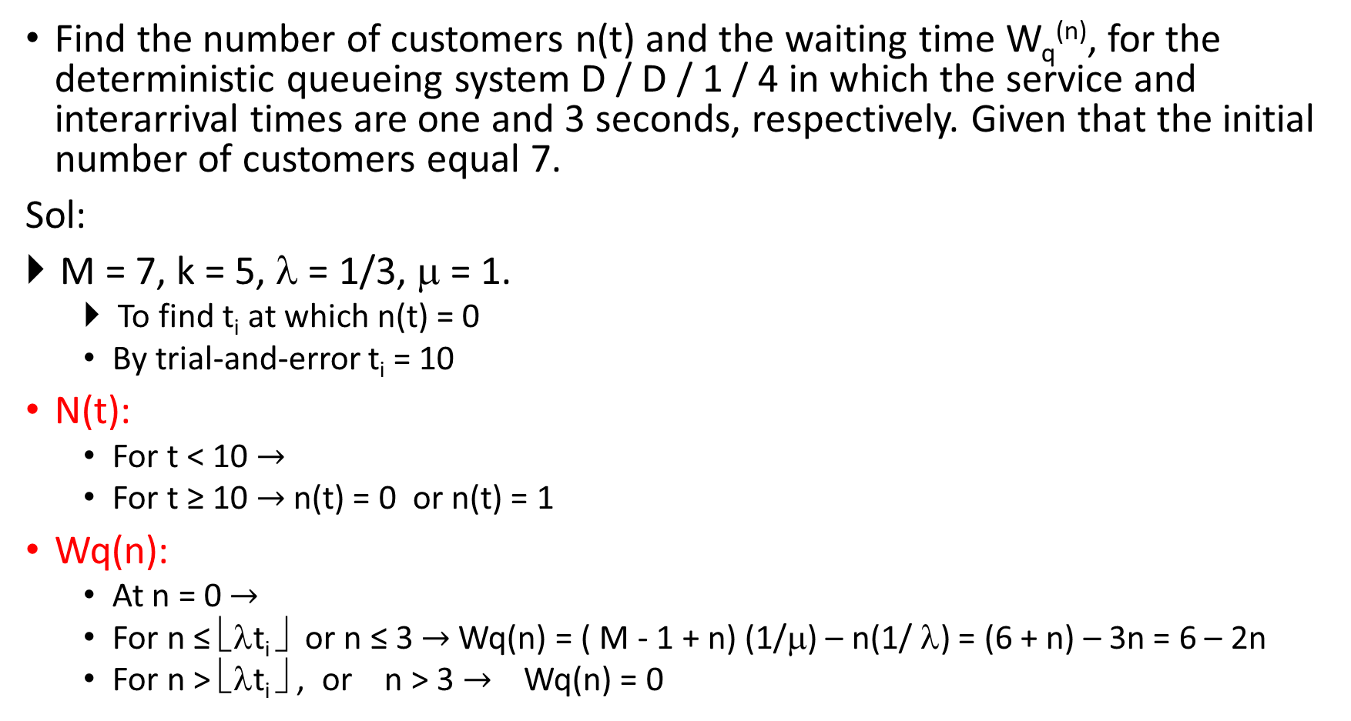
Example 4 Case2
Find the number of customers n(t) and the waiting time W_{q}^{(n)}, for the deterministic queueing system D / D / 1 / 4 in which the service and interarrival times are one and 3 seconds, respectively. Given that the initial number of customers equal 7.
Sol:
M = 7, k = 5, λ = 1/3, μ = 1.
To find t_{i} at which n(t) = 0
By trial-and-error t_{i} = 10
N(t):
For t < 10 $→$
For t ≥ 10 $→$n(t) = 0 or n(t) = 1
Wq(n):
At n = 0 $→$
For n ≤ ⎣λt_{i} ⎦ or n ≤ 3 $→$Wq(n) = ( M - 1 + n) (1/μ) – n(1/ λ) = (6 + n) – 3n = 6 – 2n
For n > ⎣λt_{i} ⎦ , or n > 3 $→$ Wq(n) = 0

Slide 6
Example 1 M/M/1
A batch processing computer system accepts user jobs assumed that they arrive according to a Poisson process with a mean arrival rate 50 jobs/hr. Jobs are executed one at a time on FIFO basis and it was found that the job execution times are exponentially distributed with an average of one minute.
λ = 50 job/hr ,1/μ = 1 min, μ = 60 job/hr.
What is the average of jobs in the computer system?
What is the average of jobs waiting for processing?
What is the percentage of time an arriving job can be processed directly?
What is the average of waiting time in the system?
What is the average of waiting time in the queue?

Slide 7

Example 2
Customers arrive at a watch repair shop according to a Poisson process at a rate of one per every 10 minutes, and the service time is an exponential r.v. with mean 8 minutes. Find the average number of customers L, the average time a customer spends in the shop W, and the average time a customer spends in waiting for service Wq.
λ=1/10 , μ = 1/8
or

Slide 8
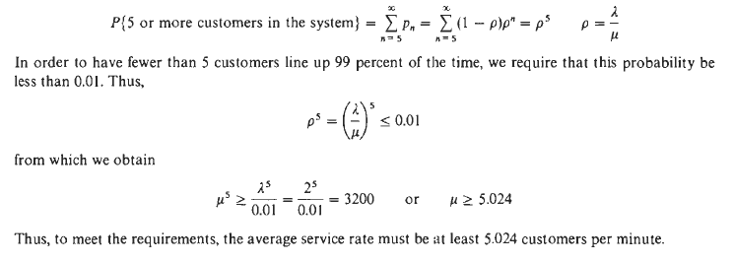
Example 3
A drive-in banking service is modeled as an M/M/1 queueing system with customer arrival rate of 2 per minute. It is desired to have fewer than 5 customers line up 99 percent of the time. How fast should the service rate be?

Slide 9

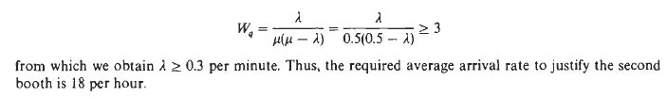
Example 4
People arrive at a telephone booth according to a Poisson process at an average rate of 12 per hour, and the average time for each call is an exponential r.v. with mean 2 minutes.
What is the probability that an arriving customer will find the telephone booth occupied?
It is the policy of the telephone company to install additional booths if customers wait an average of 3 or more minutes for the phone. Find the average arrival rate needed to justify a second booth.

Slide 10
Example 1 M/M/1/K
A minicomputer is used as a concentrator, which receives user messages, transmits then in a FIFO basis over a communication line to a remote mainframe computer. Message arrivals are assumed Poisson with a mean rate of 120 message/min, and the message lengths are assumed exponentially distributed with a mean value of 500 characters of 8 bit each. The transmission speed is 9600 bps. Find the measures of performance: W, Wq and Lq for transmission process (Transmission line is the server and the messages wait for transmission inside the concentrator.)
a) when concentrator has infinite buffer size.
b) when there are only 5 buffers.

Slide 11
Cont.
A)
B)

Slide 12
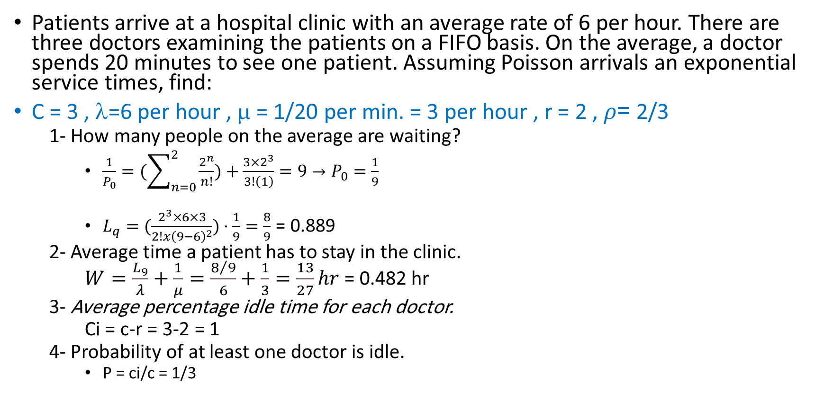
Example 1 M/M/C
Patients arrive at a hospital clinic with an average rate of 6 per hour. There are three doctors examining the patients on a FIFO basis. On the average, a doctor spends 20 minutes to see one patient. Assuming Poisson arrivals an exponential service times, find:
C = 3 , λ=6 per hour , μ = 1/20 per min. = 3 per hour , r = 2 , $ρ$= 2/3
1- How many people on the average are waiting?
$\frac{1}{P_{0}}=(\sum_{n=0}^{2}{\frac{2^{n}}{n!}})+\frac{3×2^{3}}{3!\left(1\right)}=9→P_{0}=\frac{1}{9}$
$L_{q}=(\frac{2^{3}×6×3}{2!x{\left(9−6\right)}^{2}})⋅\frac{1}{9}=\frac{8}{9}$ = 0.889
2- Average time a patient has to stay in the clinic.
$W=\frac{L_{9}}{λ}+\frac{1}{μ}=\frac{8/9}{6}+\frac{1}{3}=\frac{13}{27}hr$ = 0.482 hr
3- Average percentage idle time for each doctor.
Ci = c-r = 3-2 = 1
4- Probability of at least one doctor is idle.
P = ci/c = 1/3

Slide 13
Example 2
A corporate computing center has two computers of the same capacity. The jobs arriving at the center are of two types, internal jobs and external jobs. These jobs have Poisson arrival times with rates 18 and 15 per hour,
respectively. The service time for a job is an exponential r.v. with mean 3 minutes.
(a) Find the average waiting time per job when one computer is used exclusively for internal jobs and the other for external jobs.
(b) Find the average waiting time per job when two computers handle both types of jobs.

Slide 14
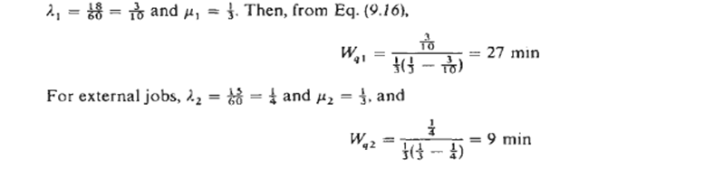
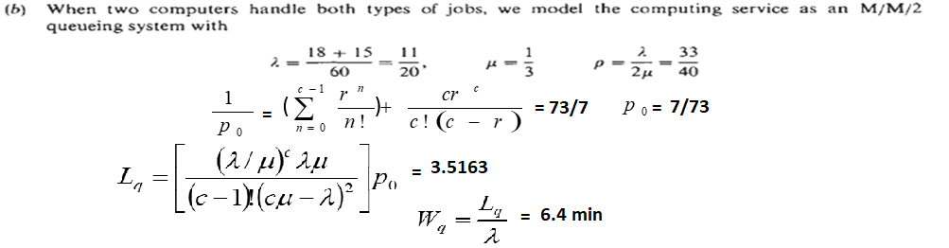
Cont.
A)

Slide 15
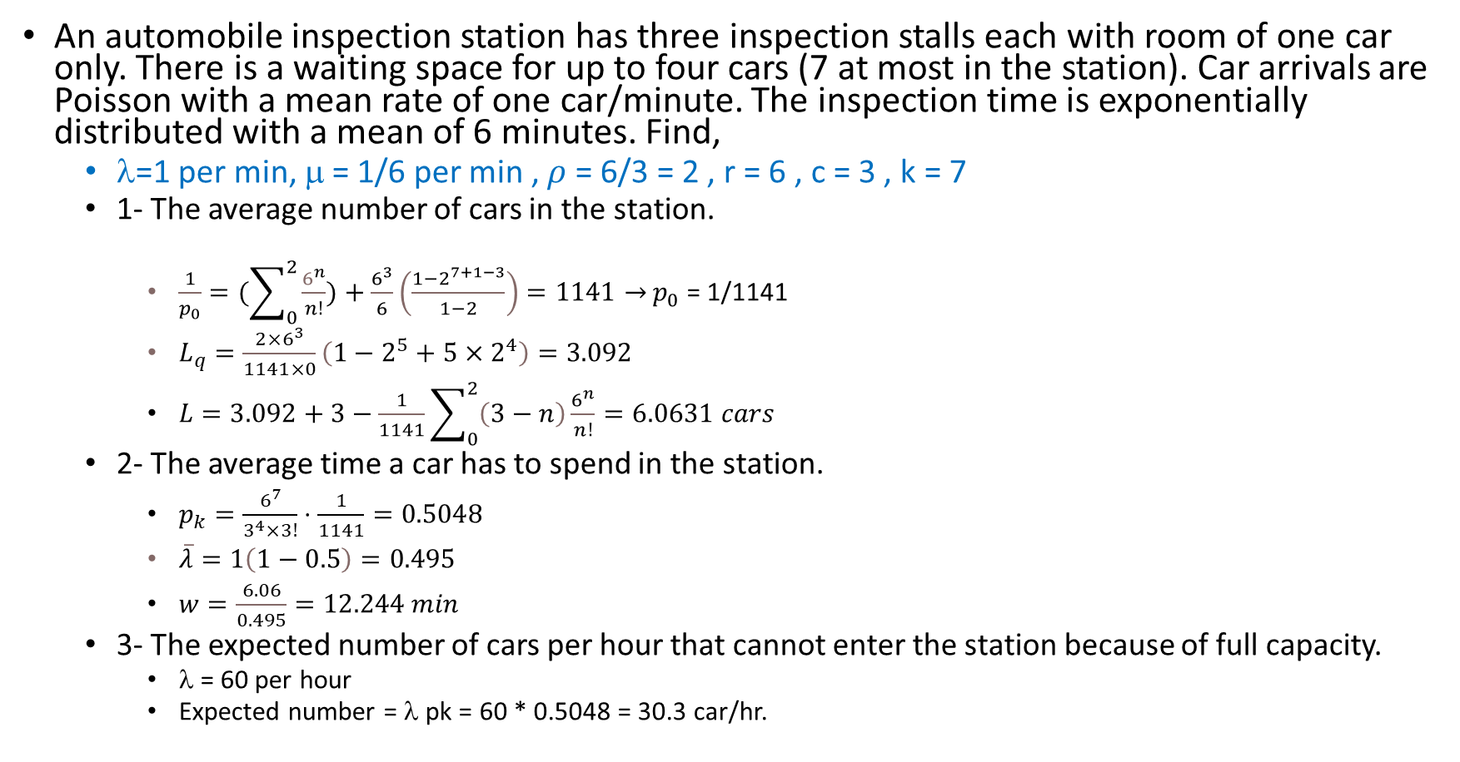
Example 1 M/M/C/K
An automobile inspection station has three inspection stalls each with room of one car only. There is a waiting space for up to four cars (7 at most in the station). Car arrivals are Poisson with a mean rate of one car/minute. The inspection time is exponentially distributed with a mean of 6 minutes. Find,
λ=1 per min, μ = 1/6 per min , $ρ$ = 6/3 = 2 , r = 6 , c = 3 , k = 7
1- The average number of cars in the station.
$\frac{1}{p_{0}}=(\sum_{0}^{2}{\frac{6^{n}}{n!}})+\frac{6^{3}}{6}\left(\frac{1−2^{7+1−3}}{1−2}\right)$ $=1141→$ $p_{0}$ = 1/1141
$L_{q}=\frac{2×6^{3}}{1141×0}\left(1−2^{5}+5×2^{4}\right)=3.092$
$L=3.092+3−\frac{1}{1141}\sum_{0}^{2}{\left(3−n\right)\frac{6^{n}}{n!}=6.0631 cars}$
2- The average time a car has to spend in the station.
$p_{k}=\frac{6^{7}}{3^{4}×3!}⋅\frac{1}{1141}=0.5048$
$\overline{λ}=1\left(1−0.5\right)=0.495$
$w=\frac{6.06}{0.495}=12.244 min$
3- The expected number of cars per hour that cannot enter the station because of full capacity.
λ = 60 per hour
Expected number = λ pk = 60 * 0.5048 = 30.3 car/hr.

Slide 16
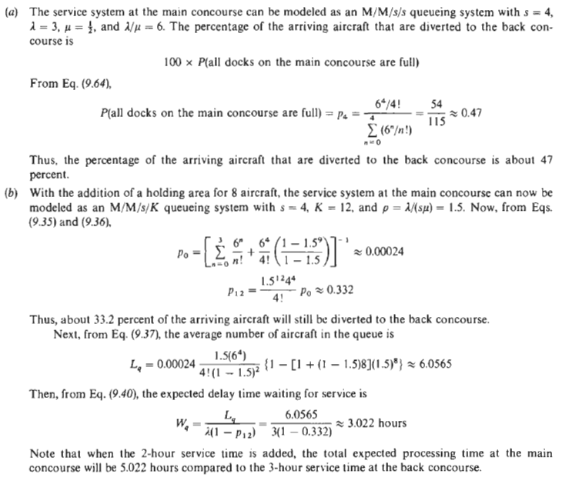
Example 2
An air freight terminal has four loading docks on the main concourse. Any aircraft which arrive when all docks are full are diverted to docks on the back concourse. The average aircraft arrival rate is 3 aircraft per hour. The average service time per aircraft is 2 hours on the main concourse and 3 hours on the back concourse.
a) Find the percentage of the arriving aircraft that are diverted to the back concourse.
b) If a holding area, which can accommodate up to 8 aircraft is added to the main concourse, find the percentage of the arriving aircraft that are diverted to the back concourse and the expected delay time awaiting service.

Slide 17
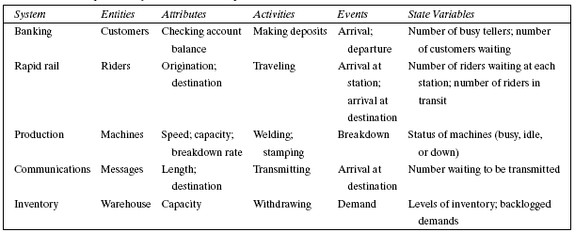
Example of system components

Slide 18
Example of simulation process
A simulation of a major traffic intersection is to be conducted with the objective of improving the current traffic flow. Write steps 1 and 2 in the simulation process of the figure mentioned before.
Problem Formulation | Setting of Objectives and Overall Project Plan
Cars arriving at the intersection are controlled by a traffic light. The cars may go straight, turn left, or turn right. | How should the traffic light be sequenced? Criterion for evaluating effectiveness: average delay time of cars. Resources required: 2 people for 5 days for data collection,1 person for 2 days for data analysis,1 person for 3 days for model building, 1 person for 2 days for running the model,1 person for 3 days for implementation.

Slide 19
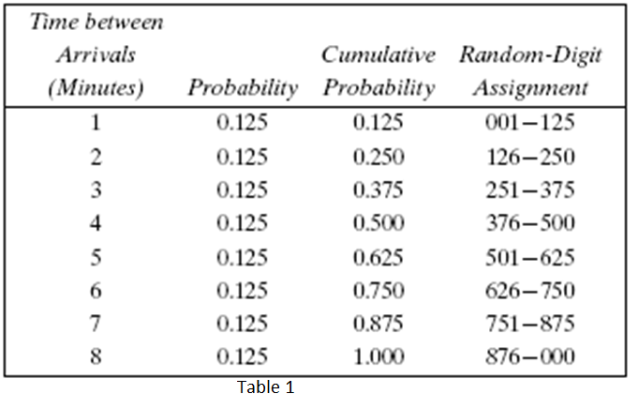
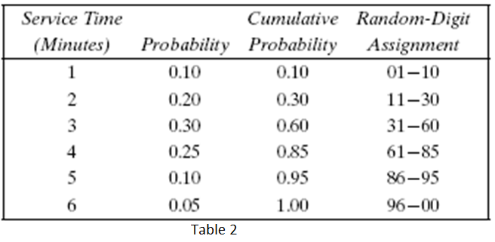
EXAMPLE: Single-Channel Queue
A small grocery store has only one checkout counter, Customers arrive at this checkout counter at random from 1 to 8 minutes apart (first column in Table 1).Each possible value of interarrival time has the same probability of occurrence (0.125), (second column in Table 1).The service times vary from 1 to 6 minutes with different probabilities (first and second columns in Table 2).

Slide 20
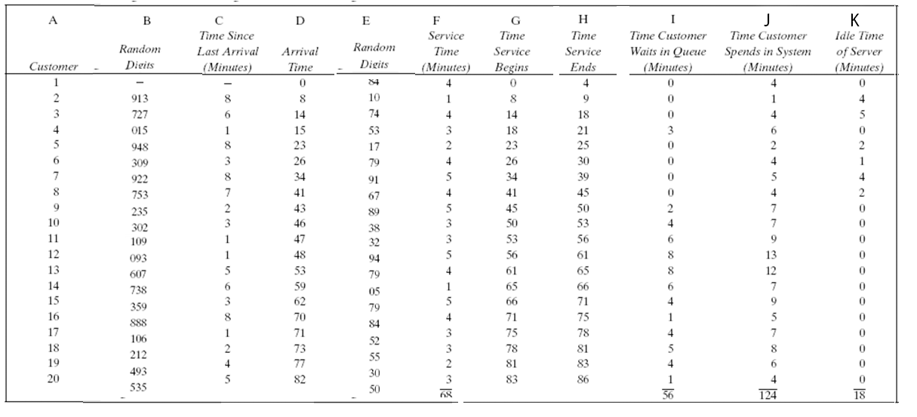
Solution Single-Channel Queue

Slide 21
Cont. , Performance
average waiting time (minutes) = 56 / 20 = 2.8 minutes
probability (wait) = 13/20 = 0.65
probability of idle server = 18 / 86 = 0.21
average service time (minutes) = 68 /20 = 3.4 minutes
Expected service time = 1(0.10) + 2 (0.20) + 3 (0.30) + 4 (0.25) + 5 (0.10) + 6 (0.05) = 3.2 minutes
average time between arrivals (minutes) = 82 / 19 = 4.3 minutes
Expected arrival time = (1 + 8) /2 = 4.5 (the probability is the same here)
Average waiting time of those who wait (minutes) = 56 / 13 = 4.3 minutes
average time customer spends in the system (minutes) = 124 / 20 = 6.2 minutes = 2.8 + 3.4 = 6.2 min

Slide 22
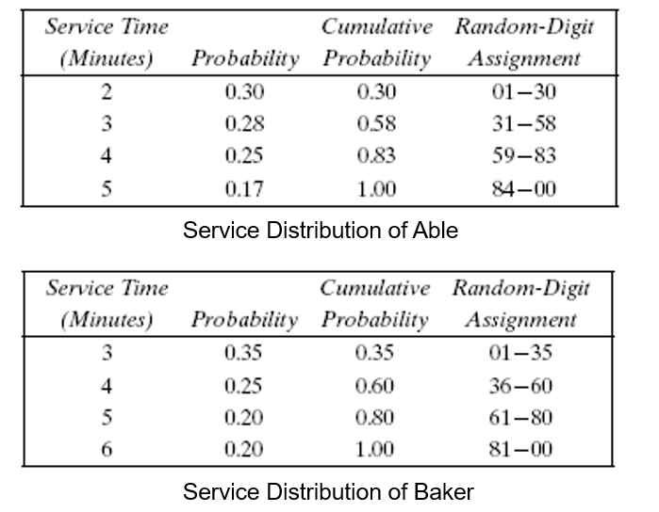
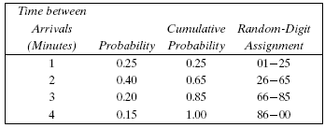
EXAMPLE: two-Channel Queue simulation
Consider a drive-in restaurant where carhops take orders and bring food to the car. There are two carhops “Able” and “Baker”. Able is better able to do the job and works a bit faster than Baker. A simplifying rule is that Able gets the customer if both carhops are idle. To estimate the system measures of performance, a simulation of 1 hour of operation is made.

Slide 23
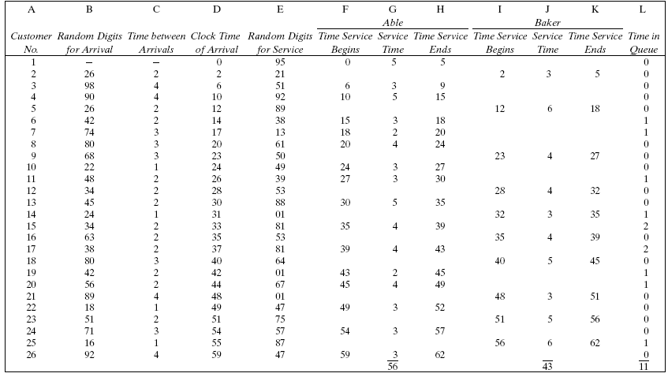
Solution two-Channel Queue simulation

